Slide 1
Security Tsunami! SDL Fundamentals and Where to Start
Safecode.org
Tania Skinner

Slide 2
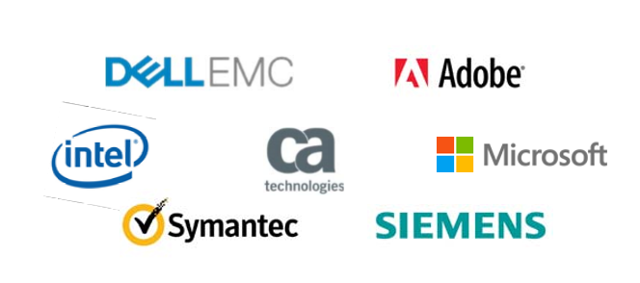
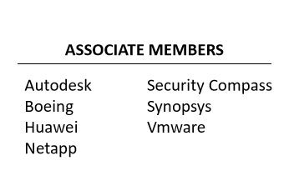
About SAFECode
The Software Assurance Forum for Excellence in
Code (SAFECode) is a global, industry‐led effort to identify and promote best practices for developing and delivering more secure and reliable software, hardware and services.
STEVE LIPNER
Executive Director

Slide 3
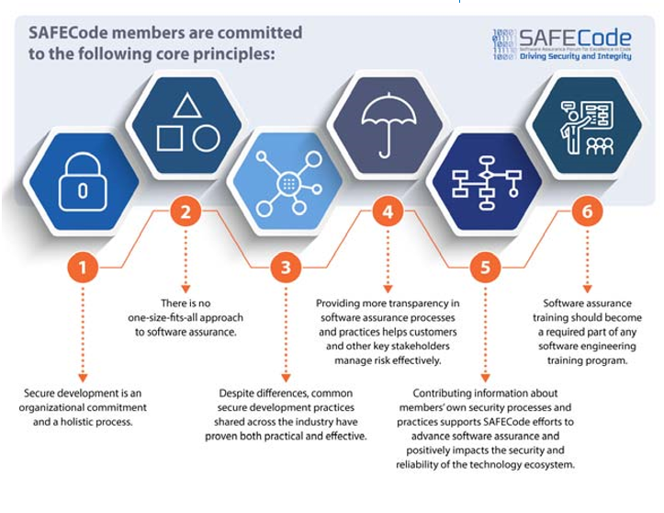
SAFECode Principles
SAFECode members have a shared commitment to the organization’s Principles:
Work together to advance software security practice
Share our experience and insights with developer community and with policymakers

Slide 4
Goals of Secure Development Initiative
Transform Culture
Seamlessly Integrate
Grow & Evolve
Notes:
When planning for the organization’s adoption of secure development practices, the goal should not be to create some isolated framework and additional set of requirements that dev teams need to do. The goal should be to transform the culture and mindset on how the organization develops products overall. Secure development is how we develop. Security considerations and requirements need to be as essential to development as the functional requirements, performance requirements, customer acceptance requirements, etc… Needs to be a part of our development DNA.
Another goal is to Seamlessly integrate secure development into development workstreams. You can’t say go do your development, now lets do this security thing and it’s a separate process and tasks that only exist on our isolated sdl tool…. If you that you have failed… Wherever possible yo uwant to integrate with existing development standards, processes and tools
And last but not least– we need to adapt, grow and evolve…. The hackers are adapting and evolving every second of every day – we need to adapt and evolve as well.
If we do our job well and are successful in transforming the culture and seamlessly integrating with development practices, security won’t be anything special it will just be one of many attributes of product development – and I will be out of a job. That said, we have a lot of work in front of us. Lets start with looking at some key themes your sdl will eventually want to address

Slide 5
Security Development Lifecycle Themes
Know what you need to protect and protect it
Use secure code & components
Validate protections
Manage issues
Continuously Improve
Notes:
This is a 50,000 foot level summary of the main themes in a security development lifecyle or as commonly known SDL. Lets dive into each of these.

Slide 6
Know what you need to protect, and protect it
What assets do you have to protect?
Who/what should have access?
Threat Modeling
Who/what should NOT?
How should you protect it?
Go to SAFECode.org for fabulous free Threat Modeling training and a paper
Notes:
To start you need to know what your product has that needs to be protected and then you need to protect it. This is typically some form of data.
The label ‘security development lifecycle’ or ‘secure development lifecycle’ implies that the work starts with development type activities. Nothing could be more wrong. A well formed SDL actually starts with requirements and never really ends. Some of the most important tasks in a healthy sdl are in fact architectural tasks. As quality professionals, I am sure you are famililar with the cost of quality model which has shown that the cost to fix a defect found later in the development lifecycle is substantially greater than the cost to fix that same defect discovered earlier. This same concept applies to secure development. It is critical that early on in development the team analyze the scope and architecture of the product and identify what assets does the product have that need to be protected, and how should you protect it. In functional requiremetns we typically address what type of user or entity can do what, in the world of security you must also explore what type of user or entity should NOT be able to do what… It’s a different perspective and one that is critical to understanding what protections you need to put in place. <<CLICK>>
Once you understand what protections are needed, you can then explore HOW to protect the assets. This is where technologies such as cryptography come into play.
This type of analysis is effectively what we call Threat Modeling in security. <<CLICK>> This word often strikes fear in architects and developers as there are voluminous tomes on this topic. Its often presented as some type of black magic but it doesn’t have tobe. You can start with these 4 simple questions and I guarantee you will find gaps in both rqmts and the architecture that could be exploited. There are some great simple introductions to threat modeling online that can help your team get started in this important assessment of the requirements and architecture. As the team matures, they can also mature their threat modeling techniques and tools and detailed analysis of data flows, interfaces, trust boundaries, etc… But the place to start is with these 4 very simple questions…

Slide 7
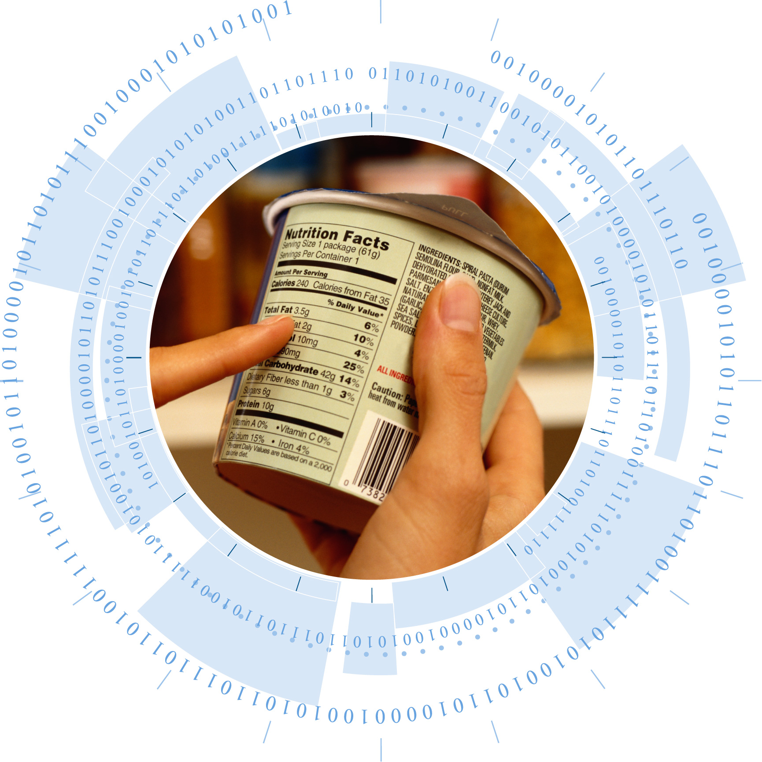
Use secure code and components
Use Secure Code
SW BOM
Coding Standards
Policy
SAFE Functions
Selection criteria
Update requirements
Current tools & defenses enabled
Automation
Dependencies
3rd Party/Open Source Components
Go to SAFECode.org for fabulous paper on Managing Security Risks Inherent in the Use of Third-party Components
Notes:
Just as you have coding standards that address quality concerns, there need to be coding standards that address security concerns. Some of the biggest security vulnerabilities are a result of the most basic coding mistakes. For example, buffer overflows/underflows and lack input validation account for a large percentage of CVEs in the national vulnerability database. Roughly 16% of CVEs in the national vulnerability database are associated with buffer errors and input validation. These are very basic coding mistakes that continue to plague us even with all the visibility they have had over the years. These aren’t the only secure coding concerns there are quite a few. You Google secure coding practices and you will find a plethora of sources online with common mistakes to look for. Research secure coding practices and integrate into your existing coding standards and code reviews.
Our developers are human – they will make mistakes. You will want to use tooling and automation wherever possible. This includes Static code analysis tools which we will discuss on next slide. You will also want to stay on top of your toolchain. Compilers are frequently updated with new defensive capabilities that can be enabled through various flags. Make sure your teams are using up to date versions of compilers and review with them the defensive flags available. Addressing secure coding standards, required compiler flags and employing some tools that do code checks are low hanging fruit – these are small incremental changes to existing development practices that can be deployed without a huge lift. So lets shift to a bigger problem. <<CLICK>> third party/open source components
Open source is here to stay and its usage in products has increased dramatically. A recent study by Synosis & Blackduck found that on average 76% of the code in a typical IOT application is open source. These components are perceived as productivity acclerators and free. Reality is they are not free and are not without risk. We have all heard of heartbleed, ghost, drown, these are all open source vulnerabilities. If you use third party cots or open source components in your development (which I can almost guarantee your developers do), you must have a policy <<CLICK>> outlining guardrails and requiremetns for usage of these components. You cannot just ‘trust’ your developers to instinctively pick components with a sound security posture – as most developers don’t even know what to look for. Your customers don’t want to hear ‘oh sorry about that breach – its not our fault – it was a vulnerability in an open source component we use…’ Any component you include in your product is your responsibility to ensure it is secure and not a source of security escapes. You need to ensure that you have policies Some areas your policy needs to address include: <<click>> This is a big complex area
Safecode has an entire paper on this topic free to download I encourage you to read.

Slide 8
Validate that protections are successful
Security Validation Toolbox
Threat Model
Static Code Analysis
Dynamic Analysis
Security/Privacy Validation Planning
Pen Testing
Fuzzing
Secure Code Review
Notes:
As quality professionals you are all very familiar with the importance of validation. While many aspects of a product’s security features can be tested via traditional Functional validation, there are many aspects of a product’s total security that is often not covered in traditional functional testing. Lets first talk about security/privacy validation planning. Teams need to explicitly develop a security and privacy validation plan – focusing on the product’s security. Earlier we talked about those 4 magical questions for our beginning threat model that identified what needs to be protected from whom and how. <<CLICK>> The answers to those questions are critical inputs into the security validation plan. Mature organizations working on high risk projects will often include validation folks in the threat modeling activity as the validation folks will look at the proposed implementations of protections and ask the question ‘how will I validate that?’ which can lead to additional implementation requiremetns to enable the validation of the protections.
The security validation plan needs to address validation of the threat model. Once you understand what you need to validate, you have to consider how you will validate it. Anywhere you can utilize automation capabilities you should! But it is not uncommon in the security space to need manual validation of certain protections. Now that we have done our planning for security validation, lets look a the tools we have. <<click>> Tools for security validation are a little different from traditional functional validation tools. There is a vast array of tools in the security space and your toolbox will need to employ a few of them – one is not sufficient. You have all heard about st Penetration testing, fuzzing, hacking and hackathons… These are all tools in the security validation toolbox. No single one of these will cover all aspects of the security validation.
Lets start with the low hangning fruit – static code analysis – super easy to implement, can be integrated into the automated build-image-test flow. Finds a lot of basic secure coding issues such as buffer overflow/underflow. Important to note that there are many different static code anlaysis tools – each tool has a set of languages it covers. If you develop in a lot of different languages – you may need multiple static code anlaysis tools. Also important to note – that they are not all created equally… some of them have very mature sets of checkers that cover a wide variety of security issues – some of them are more quality focused and don’t address a lot of common security issues. When evaluating these tools – look for coverage of languages AND security issues covered.
There are some dynamic analysis tools which can be easily configured – depending on the type of software. Pen testing and fuzzing are definitely more advanced technicques requiring a higher level of expertise and more effort. If you have a truly high risk product but don’t have an experience internal pen test team – it may be worth contracting out to an external pen test provider.
Then of course we have a secure code review – pretty easy to implement – but note that a secure code review is NOT the same as a peer review on code check-in. Peer reviews at check-in almost ALWAYS focus on the code introduced or changed from a functional perspective. The code is inspected in little snippets. With a secure code review – ideally you want to review holistically the code involved in implementing a particular security mitigation identified in the threat model (remember – the what you will protect from whom and how). There are many articles and how tos online regarding how to conduct a secure code review.

Slide 9
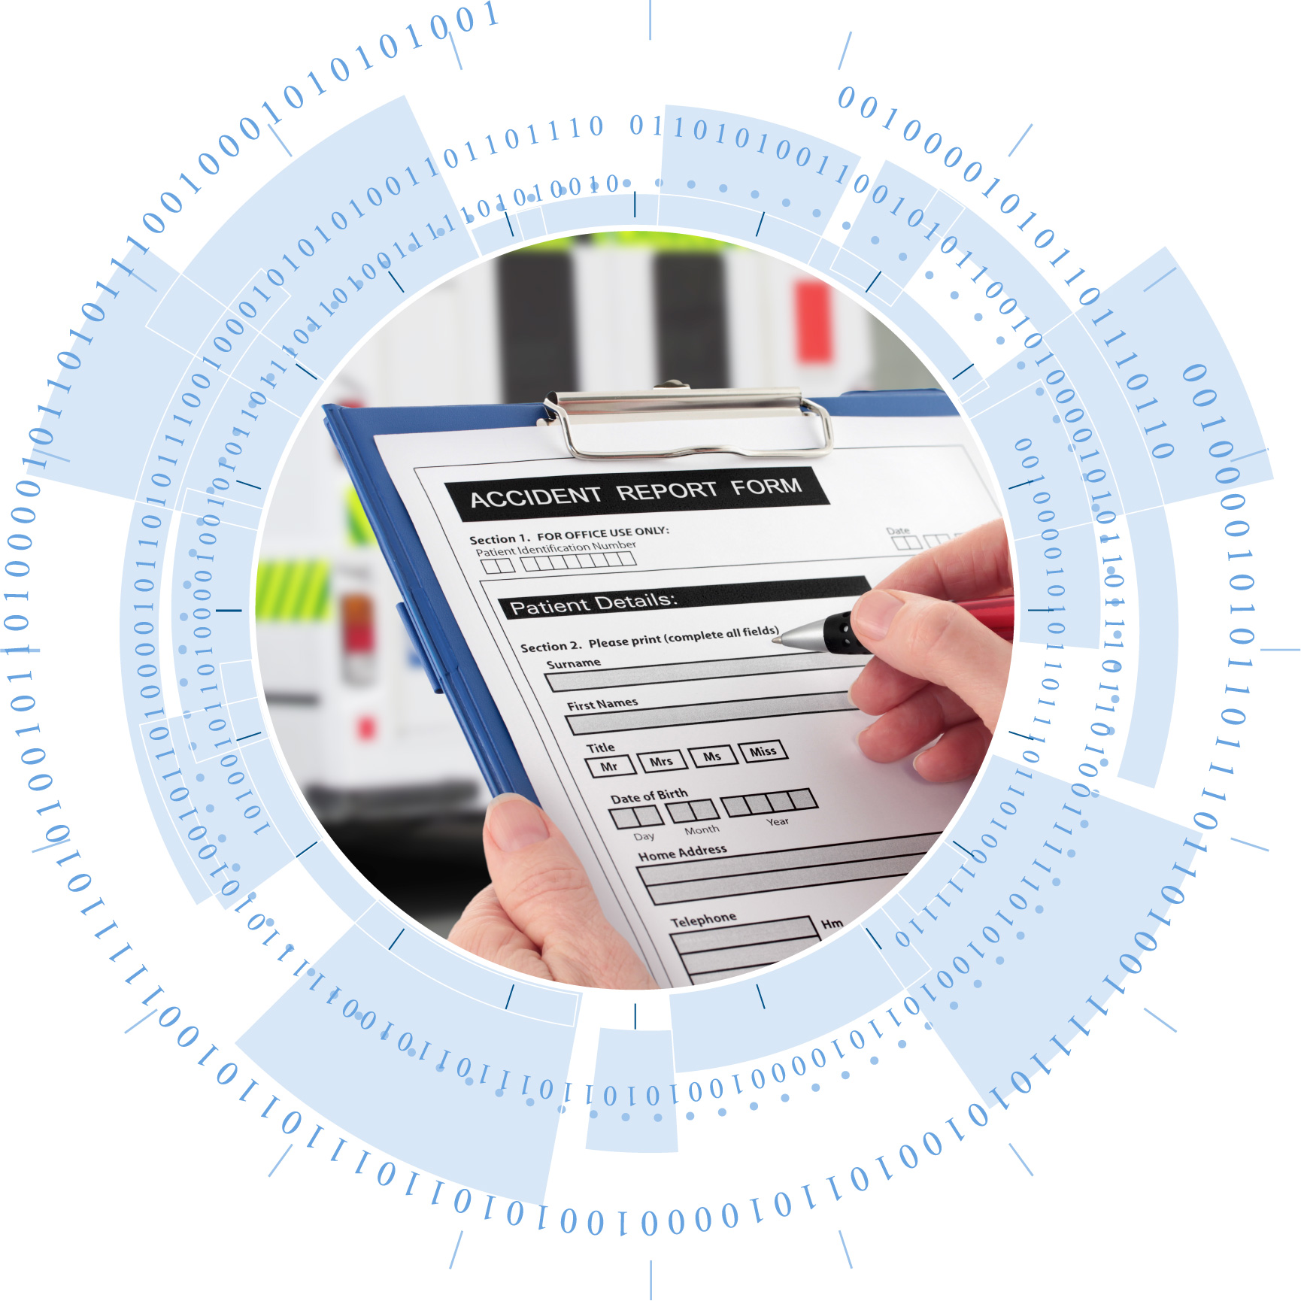
Manage issues
Severity
Policy
Likelihood
Security defects in development
Impact Assessment
Risk Assessment
Impact
PSIRT
Ability to patch
Comms/
Marketing
Security defects in shipped/shipping product
Risk
Acceptance
Criteria
Legal
Authority
Remediation
https://www.first.org/education/FIRST_PSIRT_Service_Framework_v1.0
Notes:
There are two types of security issues you will encounter: those found during development that are contained within the development project, nad those found in shipped/shipping product. In either case, you want to have a plan for how you are going to prioritize and deal with these. Both of these need to be guided by policy and process. <click>>
The policies and process need to be clearly defined before you find yourself in a difficult situation. For example: product ships tomorrow– the press release has already gone out and the marketing machine has begun….and someone accidentally discovers a vulnerability. What are you going to do? You don’t want to be trying to figure out how to handle this situation while you are living it. Have a clearly defined policy. <<CLICK>>Typical policy for dealing with issues found during development would include a formal method of assessing the severity of a vulnerability, looking at the likelihood of exploit, the ability to patch, potential impact to customer and brand damage, etc… <<CLICK>>
The policy also needs to include critieria for if and when it is acceptable to release with a vulnerability, and if/when it is unacceptable to release with a vulnerability and who the decision maker is – think about the risk and what level of mgmt. approval is required to make decisions regarding that risk.
<<CLICK>>
Now lets talk about the situation we are all trying to avoid – a vulnerability has been found in a product that is out in the field. It could be internally discovered or reported to you confidentially by a security researcher or the most unfortunate 0 day. Now you have a potential forest fire on your hands. You really want to have a robust policy for how you will handle this situation and you want the entire company to be aware of and familiar with this policy. Everyone will need to respond with great urgency in this situation so you want them to know before they are in the fire how your organization handles these situations.
The policy that applies in this case will of course include risk assessment and risk acceptance – there will be differences in your critieria and guardrails for vulnerabilities in shipping products. Now your policy also need to cover some additional things as well: <CLICK> Communications/marketing – need a technical advisory of some sort published, you will need to notify customers, you will have to identify who is authorized to speak to the media, obviously legal will need to be involved and then there is of course working with the development team on the mitigation – you got to get it patched. These ‘oh crap – we need a patch’ moments can be very distruptive to the team’s current development and can greatly impact the product roadmap. These events can be tremendously expensive. This is the situation you want to avoid – this is why you have an SDL. <<CLICK>>
The process, policies and practices associated with handling vulnerabilities in shipped/shipping product is commonly called PSIRt in the industry. PSIRT is product security incident response team and large companies have dedicated teams to handles these types of issues. FIRST has a great paper describing R&R and policies for psirt teams – I highly recommend it.

Slide 10
Continuously improve
Requirements
Finding
Finding
Release
What do we need to do differently?
Architecture/Design
Finding
Finding
Validation
Development
Notes:
Throughout this presentation we have discussed a series of secure development practices that should be applied in your development stream. Any of these activities can reveal security gaps or findings. <<CLICK>> Sometimes these findings are simply poor implementation of known practices and requirements – but sometimes it’s a gap in your practices. You want to regularly review the security defects discovered throughout development and <<CLICK>>> ask the question “what do we need to do differently?” This should also take into account feedback from teams on whats working well, whats not, etc… as well as new attacks and industry trends. <<CLICK>> Based on this information, you identify changes to make to the secure development practices. Once again, constantly evolving…

Slide 11
How to plan/roll out secure development
Development process & toolchain
Set of practices
Knowledge you need
Skills Needed
Organization culture
Set of teams
Training
Scope deployment
Mentoring
Set of projects
Expertise available
Skills
Champions
Past Escapes
Go to SAFECode.org for fabulous free training
Notes:
Remember our goals from early on - we want to transform the culture and seamlessly integrate wherever possible. There is clearly a lot that can be done – but where do you start? <<CLICK>
First – you need to uunderstand how your organization works starting with how they develop – this is critical. You can’t seamlessly integrate into a process and toolchain you don’t understand.
With this goal in mind, you need to think about integration. How do we integrate into the existing development practices?
Secure coding practices should be integrated into existing coding standards and checked for as part of existing code reviews for example.
You also need to understand the organization’s culture. In some organizations, top level mandates from above work great. In other orgs, ground swell from technical groundtroops is most effective and in yet other orgs you will want both the top level mandate as well as groundswell from some key influencers. Look into the organizations history and find examples of process simprovement initiatives that have succeeded and those that have failed. What approach did they take? What worked well? What didn’t work well. Learn from the past and adjust your approach appropriately.
You also need to understand what expertise is available that you can leverage as part of your rollout and adoption. This will also help you understand gaps in skills that you will need to work with business units to develop a plan to plug those skill gaps. You’re not going to start with an advanced pen testing team if you don’t have anyone with experience in this area….
And of course you need to know who the champions for security are – are there any? Are they influencers or leaders in the org? You will need some!! Get to know them and work on building them.
You also need to find out what security issues or problems are already known. Have you had any escapes or psirts? Has the root cause been identified? If there is a theme here that might be a really good place to start.
<<CLICK>>
Now lets talk scope of deployment. You are probably not going to deploy all practices at once to all teams as that will be pretty disruptive to your development roadmaps. We all know that there is always a hit to a team’s productivity when we introduce a new process, toolset and requiremetns as they try to learn it and apply it for the first time. You can scope the deployment in many different ways. You can deploy a set of practices to all teams at once or maybe to a set of targeted teams or maybe you start with projects that are newly launching or those that have the highest risk. There is no single right answer here – but there are many ways to skin this cat. <<CLICK>>
Last but not lease – lets look at skills. You will need to establish training – what training and when depends on what practices you are deploying and existing skill level in the org. SAFECode and other orgs have free training available online. Don’t limit your skills building to just online webe training though – look for opportunities to interactively engage with development teams and apply skills in a safe fun game like a capture the flag event. We’ve had many a discussion on effectiveness of training methods in safecode – and overwhelmingly member companies endorse capture the flag events as the most effective. Given the lack of security experts across the industry, you will want to actively develop the skills within your org. A mentorship program pairing aspiring security experts with experienced ones is always a good idea to help build this valuable skill set. <<CLICK>>

Slide 12
Summary
Transform Culture
Questions?
Seamlessly Integrate
Grow & Evolve
Join the conversation! SAFECode.org
Notes:
I know we’ve covered a lot and I’ve probably left you a bit overwhelmed. This is a really big domain and there is a lot to do and many different ways to do it. There is no perfect solution – no panacea. Keep in mind - anything you do to address this big hairy problem space is better than nothing. Find the low hanging fruit and start there. If you always keep in mind the long term goals of transforming the culture, seamlessly integrating with development practices, and constantly evolving as you go, you will incrementally achieve wins along the way approaching that security nirvana we so desperately seek – the day when security isn’t just some extra tax or extra thing we do – it’s so perfectly interlaced into how we develop products - that folks like myself are effectively out of a job – and can move onto the next big ugly. <<CLICK>> With that – do you have any questions?

